Slide 1
Unit-4
Data Collection
Presentation by
Dr. Basavaraj S. Kudachimath

Slide 2
Discussion Points
Data Collection: Meaning, types, Data collection methods: Observations, survey and interview techniques,
Questionnaire design: Meaning, process of designing questionnaire. QualitativeTechniques of data collection Secondary data Sources: advantages and disadvantages.
Measurement and Scaling Techniques: Basic measurement scales-Nominal scale, Ordinal scale, Interval scale, Ratio scale. Attitude measurement scale - Likert Scale, Semantic Differential Scale, Thurston scale,
Multi-Dimensional Scaling: Non comparative scaling techniques

Slide 3
What is Data
Data is defined as a collection of individual facts or statistics. (While “datum” is technically the singular form of “data,” it’s not commonly used in everyday language.)
Data are facts such as figures or numbers, pictures, signs, colours etc used to analyze something or make decisions.
Data can come in the form of text, observations, figures, images, numbers, graphs, or symbols. For example, data might include individual prices, weights, addresses, ages, names, temperatures, dates, or distances. Data is a raw form of knowledge and, on its own, doesn't carry any significance or purpose.
There are two main types of data:
Quantitative data is provided in numerical form, like the weight, volume, or cost of an item.
Qualitative data is descriptive, but non-numerical, like the name, sex, or eye color of a person.

Slide 4
Information
What Is Information?
Information is defined as knowledge gained through study, communication, research, or instruction. Essentially, information is the result of analyzing and interpreting pieces of data. Whereas data is the individual figures, numbers, or graphs, information is the perception of those pieces of knowledge.
For example, a set of data could include temperature readings in a location over several years. Without any additional context, those temperatures have no meaning. However, when you analyze and organize that information, you could determine seasonal temperature patterns or even broader climate trends. Only when the data is organized and compiled in a useful way can it provide information that is beneficial to others.

Slide 5
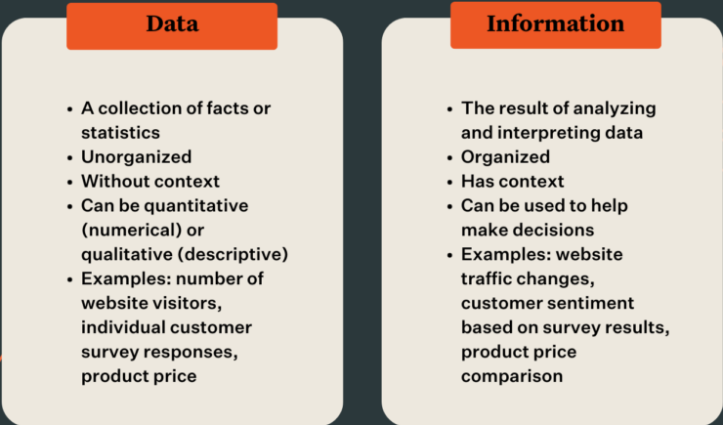
Differences between Data and Information

Slide 6
Types of data
Primary Data: It may be
i) qualitative data or
ii) quantitative data
Secondary data: It may be
i) qualitative data or
ii) quantitative data

Slide 7
Primary Data
Primary data is known as the data collected for the first time through field survey. Such data are collected with specific set of objectives to assess the current status of any variable studied.
Primary data always reveal the cross section picture of any thing studied. This is needed in research to study the effect or impact of any policy.
For example, suppose the Transport department wants to study whether introduction of one way regulation in a main road has helped to release the traffic congestion. This can be studied only by collecting information on the spot for a few days from the common public, vehicle using population, shop keepers, policemen on duty and others who are directly affected by such a one way regulation. Such an information is called primary date.

Slide 8
Advantages of Primary data
Gives more accuracy of research.
Gives live input for decision making.
Easy to settle queries.
Latest data makes research more reliable.

Slide 9
Disadvantages
Not suitable for all types of research.
Difficult to check accuracy of research.
Researcher should be efficient enough to collect the data

Slide 10
Sources of Primary Data
Schedule or Questionnaire (Survey method)
Interview
Observation
Feedback Form
Sales force Opinion
Pantry Audit.
Consumer Panel
Collection through mechanical device.

Slide 11
Survey method tools
Schedule & questionnaire
The survey method is a primary data collection technique that gathers information from a targeted group of respondents using structured schedules or questionnaire.

Slide 12
Meaning &Types of schedule
Schedule is a sheet of paper containing questions relating to certain specific aspect, about which the scholar is collecting data. But the schedule is not sent to the informant. It is taken by the researcher, used by him while eliciting information. The reply is recorded by the researcher himself against each question. Hence, the schedules are different from questionnaires only in respect of usage.

Slide 13
Types of Schedules
1. Interview Schedule
Used in face-to-face or remote interactions, where the enumerator asks the questions exactly as written and records the respondent's answers.
Structured: Features predetermined questions in a strict order.
Unstructured / In-depth: Provides a framework of topics to guide a conversation, allowing for flexible follow-up questions.
2. Observation Schedule
Utilized when the researcher's primary method is observing behaviors, activities, or conditions rather than directly asking questions.
The observer watches a subject (e.g., in a classroom, clinic, or community) and records specific actions on a standardized form
3. Rating Schedule
Designed to measure the trend, value, or intensity of qualitative elements such as attitudes, opinions, preferences, or inhibitions.
These are heavily utilized in psychology and business to quantify subjective traits (e.g., measuring satisfaction levels using numerical scales or scoring).
4. Document Schedule
Used to extract specific information from historical records, written evidence, archives, and case histories. Rather than asking people, the enumerator gathers data by tracking how often specific terms or functional issues occur in existing documents.
5. Institutional or Evaluation Schedule
Used to gather in-depth data about specialized organizations, agencies, or institutions.
The size and complexity of this schedule scale with the nature and complexity of the institution being evaluated
6. Demographic/Household Schedule
Commonly used in large-scale social surveys and census research to collect general information about a community or family unit.
Gathers full demographic details including age, sex, occupation, education, and family relations.

Slide 14
Dr Bhatras schedule for investigating alopecia in patients
To be filled by primary investigator ( Enumerator). Name: Date___________
Proforma for Investigating Alopecia
1. Patient History
Onset and duration of hair loss (acute, chronic, sudden, gradual)
  Ans_______________________
Pattern of hair loss (diffuse, patchy, focal, patterned)
  Ans________________
Associated symptoms: itching, pain, burning, scaling, erythema
  Ans________________________
Personal and family history of hair disorders or autoimmune diseases
  Ans___________________
Recent illnesses, stress, or major life events.
  Ans___________________
Medications (including recent changes)
  Ans_________________________

Slide 15
2. Physical Examination (Densitometry test)
Densitometry scalp and hair inspection: distribution, pattern, and extent of hair loss; presence of scarring, scaling, erythema, pustules, or atrophy.
Report result________________________________
Examination of other hair-bearing areas: eyebrows, eyelashes, beard, body hair
Ans_____________________________
Nail examination: pitting, ridging, other abnormalities
Ans________________
Skin examination: look for signs of systemic disease (e.g., lupus, lichen planus) etc
Ans____________________

Slide 16
3. Diagnostic Tests
Hair pull test: Gently pull 20–60 hairs; >10% release suggests active shedding
  Ans____________________
Hair tug test: Assesses hair shaft fragility
  Ans_________________
Trichoscopy (dermatoscopy): Non-invasive visualization of hair and scalp for characteristic features (e.g., yellow dots, exclamation mark hairs, follicular ostia) Card test: Assesses new hair growth and shaft abnormalities.
  Ans____________________
4. Laboratory Investigations
Complete blood count (CBC)
  Test Results__________________
Thyroid function tests (TSH, free T4)
  Test Result_______________
Serum ferritin (iron stores)
  Ans________________
Vitamin D levels
Ans___________________

Slide 17
5. Additional Diagnostic Procedures
Scalp biopsy: If diagnosis is unclear or scarring alopecia is suspected (usually a 4-mm punch biopsy from the active margin)
Ans___________________
Fungal studies: KOH preparation and/or fungal culture if tinea capitis is suspected
Ans___________________
Microscopy of hair roots: To distinguish between anagen and telogen hairs, or identify shaft abnormalities.
Test results________________________

Slide 18
Advantages of Schedules
Suitable for the illiterate: Because an enumerator reads the questions and records the answers, this method can easily gather data from respondents who cannot read or write.
High response rates: Direct, face-to-face interaction virtually eliminates the problem of non-response since the enumerator is present to prompt answers to all questions.
Fewer misunderstandings: If a respondent misinterprets a question, the enumerator can clarify the context immediately, ensuring more accurate data.
Complete information: Enumerators ensure that no questions are skipped and the gathered data is comprehensive.
Disadvantages of Schedules
Costly: Hiring, training, and deploying a team of enumerators to the field requires significant financial investment.
Time-consuming: Collecting data face-to-face over large geographic areas or sample sizes is considerably slower than sending out mass mail questionnaires.
Interviewer bias: The presence and demeanor of the enumerator, or their potential misinterpretation of responses, can consciously or unconsciously influence the data.
Requires highly trained staff: The reliability of the data depends entirely on the honesty, dedication, and competence of the field enumerators

Slide 19
Questionnaire
A questionnaire is a sheet [s] of paper containing questions relating to certain specific aspect, regarding which the researcher collects the data. The questionnaire is given to the informant or respondent to be filled up. Sometimes questionnaire is also in the form of files generated through computer. This is usually called soft copy of questionnaire.

Slide 20
Advantages of Questionnaire Method
1. It involves lesser cost as questionnaire could be sent by post to a wide area
2. It does not interfere with the respondent while answering the question
3. The bias of the investigator is completely eliminated.
4. Respondents are given sufficient time to fill up the questionnaire.
5. If respondents cannot be reached personally, questionnaire is the alternative method available.
6. This method is useful when the sample size is very large
7. If the questionnaire is designed properly with instructions, then the time and cost of recruiting, training, supervising and controlling the investigators is saved.
8. Confidentiality is ensured as the respondents directly send the filled up questionnaire to the researcher.

Slide 21
Limitations of Questionnaire Method
1. It is always found that the response rate in questionnaire is very poor compared to using schedules.
2. Bias of the respondent cannot be determined easily.
3. Only if the respondents are educated, questionnaire could be used for collecting information
4. Follow up of non - response or unfilled questionnaire only adds to the cost and time.
5. There is no scope for giving any clarification to the respondents in case of need.
6. Accuracy of response cannot be ensured.
7. A lot of care is required to design and structure a questionnaire. Hence, unless a scholar is good at drafting a questionnaire, this method cannot be adopted for data collection.

Slide 22
Differences between Questionnaire and Schedule
BASIS OF DIFFERENCE | QUESTIONNAIRE | SCHEDULE
Usage | Respondent himself records the answers obtained | Researcher or his trained representative records the answers
Cost | Relatively cheaper as it is sent by mail to the targeted respondents | Relatively costly as it is recorded with personal presence
Coverage | Wide coverage possible, as it can be sent to any place by post | Very expansive for wide coverage
Degree of Response | Degree of response is low | Degree of response is high
Quality of Response | Not good, as the respondent answers the questions the way it is understood | Skill of researcher persuades the respondent to respond effectively
Identification of Respondent | It is not known clearly who answered the questionnaire and this in turn might affect accuracy of information obtained | More accurate information can be sought

Slide 23
Prerequisites of Questionnaire
1. The scope of the survey should be clearly determined in advance. This will help to determine the segment of informants or respondents from whom the information should be collected
2. The purpose of the survey must be established and stated in the questionnaire
3. The researcher should prepare the draft questionnaire and revise it until it is fit for the purpose of enquiry.
4. Follow up arrangement after dispatching the questionnaire should be planned in advance.
5. Maintenance of list of respondents, to whom the questionnaire is sent, is necessary.
6. Whether to use structured or unstructured questionnaire is an important decision to be taken.
7. Time frame for different activities connected with the questionnaire like, preparation of questionnaire, its finalisation, printing, collecting list of respondents and their addresses, despatch and follow up, etc.

Slide 24
Constructing Questionnaire
1. Questionnaire should be printed / cyclostyled / xeroxed
2. The first part of the questionnaire should specify the object or purpose for which the information is required.
3. An assurance to the respondent that the information furnished would be kept confidentially must be given.
4. Some introduction about the person / organisation who is collecting the information is to be given. Sometimes, this is given as a letter enclosed with the questionnaire.
5. Questions should be constructed using simple language and technical jargons, terms, concepts should all be avoided.
6. Questions should never be lengthy. It is wiser not to combine a number of questions in one question itself.
7. Each question should be specific and clear.
8. Personal questions on wealth, habits, etc., could be avoided.
9. Questions should be given in a sequence. [For example, Question relating to marital status should precede the question about the number of children]
10. Questions should not require any referencing before replying.
11. Questions should not force the respondent to recall from his memory anything to answer.

Slide 25
12. Questions needing computation / calculation / consultation should be avoided.
13. Questions on sentiments / belief / faith should be avoided.
14. Repetition of question should be eliminated.
15.In case of any instruction is required for filling up the questionnaire, such instructions should be given separately specifying the question number and the related instructions. For example, the Application form for University Examination, is given with instructions sheet regarding fees to be paid, mode of payment, subject code, etc.
16. Sufficient space should be given for answering questions
17. The questionnaire should be made attractive, as otherwise, the respondents may not be motivated to answer.
18. If any diagramme or map is used, then it should be printed clearly.
19. Questions, which, cross check the response, could be built in to the questionnaire.
20. Instructions regarding how to return the filled up questionnaire must be given. It is desirable that a self-addressed sufficiently stamped envelope is sent along with the questionnaire to enable the respondents to send the filled up questionnaire.

Slide 26
Steps involved in preparing questionnaire
1. Define the Purpose and Objectives
  Clearly identify what information you need to collect and why. This involves reviewing your research objectives or project goals to ensure each question serves a specific purpose
2. Identify the Target Audience
  Determine who will be answering the questionnaire. Understanding the demographics, language proficiency, and characteristics of your respondents helps tailor the questions appropriately.
3. Choose the Method of Distribution
  Decide how you will reach your respondents (e.g., online, face-to-face, telephone, mail), as this can influence question format and length.
4. Draft a Comprehensive List of Questions
  List all potential questions that could help achieve your objectives. At this stage, focus on content rather than wording or order.

Slide 27
5. Refine Question Wording and Format
  Develop clear, concise, and unbiased questions. Choose between open-ended and closed-ended formats as appropriate. Ensure questions are easy to understand and avoid ambiguity, leading, or sensitive questions unless necessary.
6. Organize Questions in a Logical Sequence
  Arrange questions to create a natural flow, typically starting with simple or general questions and progressing to more complex or sensitive ones. This helps keep respondents engaged and improves data quality.
7. Decide on Response Formats
  For each question, determine the type of response required (e.g., multiple choice, Likert scale, short answer) and ensure response options are exhaustive and mutually exclusive where applicable.
8. Check Questionnaire Length and Layout
  Ensure the questionnaire is not too long, as this can reduce response rates. Format the questionnaire for clarity, with clear instructions and an appealing, easy-to-follow layout.

Slide 28
9. Pretest (Pilot) the Questionnaire
  Test the questionnaire on a small sample from your target audience to identify confusing questions, layout issues, or other problems. Use feedback to make necessary revisions.
10. Finalize and Distribute
  Make final adjustments based on pilot feedback. Ensure the questionnaire is ready for distribution and then administer it to your target population.

Slide 29
Interview Techniques

Slide 30
Discussion Points
Meaning& role,
Objectives ,
Types,
The process,
Advantages and Disadvantages

Slide 31
Meaning of Interview
One of the very old methods of compiling data [facts] is the interview method. Interview method involves direct or indirect meeting of the respondent by the researcher. The researcher determines the questions to be raised at the time of interview and then elicit the response for them. The reply given is either written down in a note - book or recorded in audio or video cassette. This method has to be necessarily adopted whenever details regarding any confidential matter are to be collected or when authentic information about any thing is to be obtained or the research requires data collection directly from the respondents or there is no other way of collecting data.

Slide 32
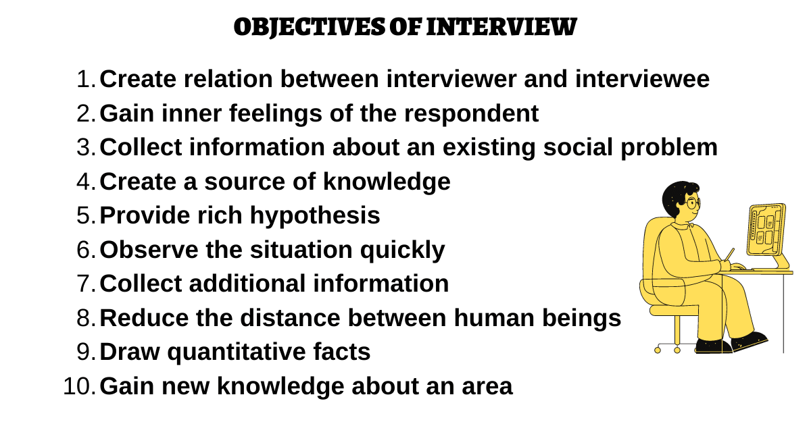

Slide 33
Types of Interviews
1. Direct interviews : The direct interview method is a real-time, face-to-face (or synchronous virtual) conversation where an interviewer asks questions directly to a subject or candidate. It is widely used in qualitative research, journalism, and job recruitment to gather first-hand insights, attitudes, and behavior
a. Structured Interview: It uses a fixed set of standardized questions asked in the exact same order for every candidate.
b. Unstructured Interview: Unstructured interviews are informal and exploratory. There are no set questions, and the direction of the interview is driven by the candidate’s previous answers and the natural flow of the conversation
2. Indirect interviews: The indirect interview method (often called indirect oral investigation) is a technique where an investigator collects information by questioning third parties rather than the primary subject. It is primarily used when the main subject is unreachable, hesitant, or likely to provide biased or inaccurate information

Slide 34
Merits of Interview method
1. Interview enables personal contact with which factual information could be obtained.
2. The interviewer can guide the respondents to understand the questions and suitably rephrase or modify the questions.
3. The non-response in this category of data collection is low.
4. Spontaneous reply of the respondents can be obtained which would truly reflect their opinion.
5. Interviewer has the flexibility to handle the interview to collect relevant information.
6. The interviewer can combine observation with interview so that a lot of additional information about the environment, nature, behaviour and attitude of the respondent could also be noted.
7. The interviewer can be persuasive to obtain the response of the respondent while this may not be possible in the case of questionnaire method of data collection.
8. The interviewer can adopt himself better by using the language with which he can reach the respondents better and the educational level of the respondent.
9. It is also possible to obtain personal information which will not be revealed through questionnaire.

Slide 35
Demerits of Interview Method
1. This method presupposes the existence of rapport between the respondent and the interviewer. In case there is no rapport, the interview cannot be held at all.
2. It is a costly method of data collection, as the interviewers should be trained, oriented and supported.
3. The time taken for covering a large sample of respondents is more than what it is under questionnaire method.
4. It is possible for a respondent to conceal his real opinion or views and so genuine data may not be available.
5. The interviewer may also be biased and thereby his bias may influence the interview outcome.
6. Interview method requires an elaborate organisational arrangement.
7. Sometimes this method cannot be followed as it would require fixing up appointment, specifying the questions that are to be answered, duration of interview, the person interviewing, the organizational background, the purpose of interview, etc., Inspite of providing all these information, it may not be possible to get an appointment to conduct the interview.

Slide 36
Observation
Presentation by,
Prof. Basavaraj S.K

Slide 37
Discussion points
Meaning & characteristics,
Types,
Advantages & disadvantages

Slide 38
Meaning
Observation may be defined as, "sensible application of sense organs in understanding less explained or unexplained phenomena." Using the sense organs, one could see and understand things. One could listen to what is being explained to understand anything. One may also understand things using the power to smell or feeling of touch. It is also possible by interacting with people to understand anything. Whenever a researcher is unable to compile information through any other method, then he has to effectively apply his sense organs to observe and explain. So it may be said that observation involves recording of information applying visual understanding backed by alert sense organs.

Slide 39
Types of observations
Structured observation : When observation takes place strictly in accordance with a plan or a design prepared in advance, it is called structured observation.
2. Unstructured observation : In this type of observation, there is no advance designing of what, how, when , who, etc., of observation. The observer is given the freedom to decide on the spot, to observe everything that is relevant.
3. Participant observation : In this method, the observer is very much present in the midst of what is observed. For example, suppose a researcher is studying the life style of a hill tribe, then he might understand the life style of the tribe better only when he stays with them.
4. Non-participant observation : This is a method in which the observer remain detached from whatever is happening around and does not involve himself in any activities taking place. He is present only to observe and not to take part in the activities.

Slide 40
5. Controlled observation : This is a slightly modified version of structured observation. In this case, the observer performs his work in an environment or situation, which is very much planned or designed or set. For example, sometimes to test the effectiveness and alertness of air port security system, mock event [like hijacking or fire accident] is carried out.
6. Uncontrolled observation : This method is a modified version of unstructured observation. No attempt is made to intervene the naturalness of the environment or situation. The observer is at freedom to observe whatever is taking place around him in the natural set up. For example, an animal lover may like to watch the conduct and behavior of the animals in their natural habitat.

Slide 41
Merits of observation method of data collection( Advantages)
1. If observation is done correctly, the scope for bias is very much minimized.
2. Through observation, the current scenario in which anything is happening is noticed and explained. There is no interpretation of how things would have happened in the past or will happen in future, etc.
3. As there is no need to get any reply or details from the respondents, observation does not require any cooperation of the respondents.
4. This is a fairly reliable method, provided the observer is well experienced, trained and sincere.
5. Whenever respondents are illiterate or incapable of answering any question, [due to language barrier or cultural background, etc], observation is the only method of data collection available.

Slide 42
Limitations ( Disadvantages)
1. This is a relatively costly method of data collection, because the observer has to be present on the spot to observe whatever is happening. Further training an observer is the additional cost to be incurred.
2. The scope for the bias of the observer interfering in what is observed and understood is high.
3. It could be noticed that what is observed may bring out only part of the facts, while data collected through questionnaire or interview ensure better coverage.
4. Sometimes, it may not be possible to observe what is targeted. This may be due to the difficulty in reaching such people or spot.
5. There is a lot of scope for the observer to get distracted or influenced by
unexpected factors which would affect the accuracy of information collected.
6. A very important limitation is that only the observer can effectively establish link among whatever he has observed to give a meaningful interpretation. Based on his report nobody else can give satisfactory interpretation. Therefore, the ability to relate things and interpret them intelligently is a quality expected of an observer.

Slide 43
Secondary Data
Secondary data refers to the information or facts already collected. Such data are collected with the objective of understanding the past status of any variable. Or the data collected and reported by some source is accessed and used for the objective of a study. Normally in research, the scholars collect published data, analyse them, to explain the relationship between variables, which may not have been studied or the relationship might be explained in a new way. For example, data relating to production and productivity of rice in Tamil Nadu may be analysed by different scholars for different purposes.

Slide 44
Advantages
Research is more accurate.
Past data is having record.
Third party can test the accuracy of research.
Evidences prove the research hypothesis.

Slide 45
Disadvantages
Not suitable for all types of researches.
Requires authentic sources.
No personal inqiry is possible.

Slide 46
Sources of Secondary Data
Books.
Periodicals.
Research thesis and dissertation.
Bibliographies.
Encyclopedia.
Statistical data source.
Directories and year book.

Slide 47
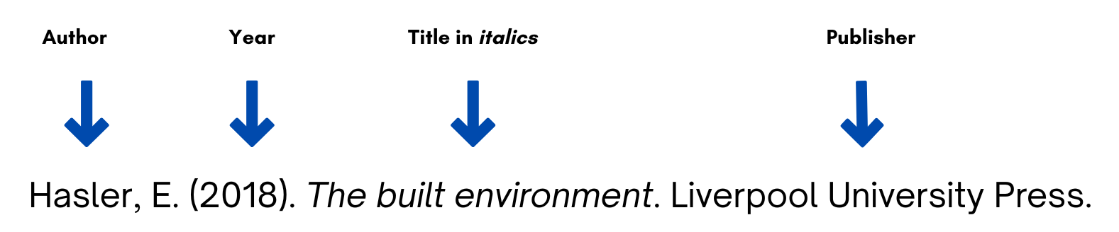
How to give citations
Referencing a book
Basic format to reference a book
Author or authors. The surname is followed by first initials.
Year of publication of the book (in round brackets).
Book title (in italics).
Edition (in round brackets), if other than first.
Publisher.

Slide 48
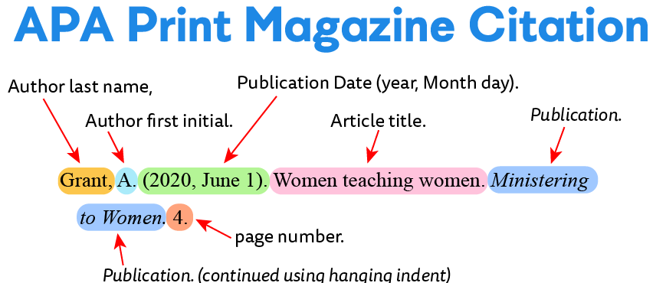
2. Periodical referencing

Slide 49
Referencing Research thesis / dessertation

Slide 50
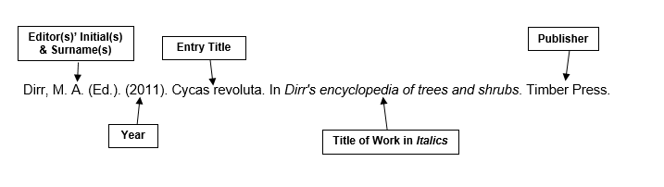
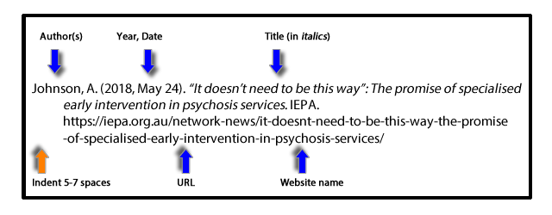
Referencing Encyclopedia.
Referencing websites

Slide 51
Selection of Appropriate Method of Data Collection
Nature and scope and objective of the research.
Budget Constrain.
Availability of Time.
Degree of Accuracy required.
Period of study.

Slide 52
Measurement and Scaling Techniques:
Discussion Points.
A. Basic measurement scales-
Nominal scale,
Ordinal scale,
Interval scale,
Ratio scale.
B. Attitude measurement scale –
Likert Scale,
Semantic Differential Scale,
Thurston scale,

Slide 53
Scales of Measurement
The process of assigning numbers to objects in such a way that specific properties of the objects are faithfully represented by specific properties of the numbers. Such ways of assigning numbers do not attempt to measure the total phenomenon, but only a specific set of attributes.

Slide 54
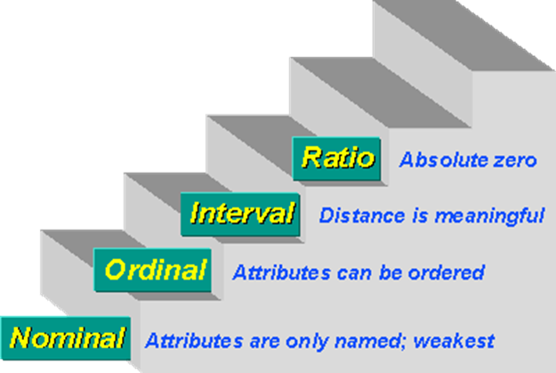
A. Basic measurement scales:
Nominal scales
Ordinal scales
Interval scales
Ratio scales

Slide 55
1. Nominal Scale:
A nominal scale of measurement deals with variables that are non-numeric or where the numbers have no value. The lowest measurement level you can use, from a statistical point of view, is a nominal scale. A nominal scale, as the name implies, is simply some placing of data into categories, without any order or structure.
A physical example of a nominal scale is the terms we use for colors. The underlying spectrum is ordered but the names are nominal. In research activities a YES/NO scale is nominal. It has no order and there is no distance between YES and NO.

Slide 56
2. Ordinal Scale:
The ordinal type allows for rank order (1st, 2nd, 3rd, etc.) by which data can be sorted, but still does not allow for relative degree of difference between them.
An ordinal scale of measurement looks at variables where the order matters but the differences do not matter. When you think of 'ordinal,' think of the word 'order.' In the case of letter grades, we don't really know how much better an A is than a D. We know that A is better than B, which is better than C, and so on. But is A four times better than D? Is it two times better?
In this case, the order is important but not the differences. Examples include, on one hand, dichotomous data with dichotomous (or dichotomized) values such as 'sick' vs. 'healthy' when measuring health, 'guilty' vs. 'innocent' when making judgments in courts, 'wrong/false' vs. 'right/true' when measuring truth value, and, on the other hand, non-dichotomous data consisting of a spectrum of values, such as 'completely agree', 'mostly agree', 'mostly disagree', 'completely disagree' when measuring opinion.

Slide 57

3. Interval Scale:
Interval scales are numeric scales in which we know not only the order, but also the exact differences between the values.
The classic example of an interval scale is Celsius temperature because the difference between each value is the same. For example, the difference between 60 and 50 degrees is a measurable 10 degrees, as is the difference between 80 and 70 degrees. Time is another good example of an interval scale in which the increments are known, consistent, and measurable

Slide 58
4. The ratio scale
The ratio scale of measurement is the most informative scale. It is an interval scale with the additional property that its zero position indicates the absence of the quantity being measured. You can think of a ratio scale as the three earlier scales rolled up in one. Like a nominal scale, it provides a name or category for each object (the numbers serve as labels). Like an ordinal scale, the objects are ordered (in terms of the ordering of the numbers). Like an interval scale, the same difference at two places on the scale has the same meaning. And in addition, the same ratio at two places on the scale also carries the same meaning.
Ratio scales are the ultimate nirvana when it comes to measurement scales because they tell us about the order, they tell us the exact value between units and they also have an absolute zero–which allows for a wide range of both descriptive and inferential statistics to be applied. Everything above about interval data applies to ratio scales i.e. ratio scales have a clear definition of zero.
Good examples of ratio variables include height and weight. Ratio scales provide a wealth of possibilities when it comes to statistical analysis. These variables can be meaningfully added, subtracted, multiplied, divided (ratios). Central tendency can be measured by mode, median, or mean; measures of dispersion, such as standard deviation and coefficient of variation can also be calculated from ratio scales.

Slide 60
Scale | Meaning | Characteristics | Management Examples
Nominal Scale | Used for naming or categorizing | No order, no ranking | Gender (Male/Female), Department (HR, Finance, Marketing), Marital Status, Type of Bank Account, Brand Preference (Samsung, Apple, Vivo)
Ordinal Scale | Used for ranking or ordering | Order exists, but differences are not equal | Customer Satisfaction (Very Dissatisfied to Very Satisfied), Employee Performance Rating (Poor, Average, Good, Excellent), Class Rank, Socio-economic Status (Low, Middle, High)
Interval Scale | Ordered with equal intervals, but no true zero | Addition and subtraction possible | Temperature (°C, °F), IQ Score, Calendar Years (2023, 2024, 2025), Employee Attitude Scores from standardized scales
Ratio Scale | Ordered with equal intervals and a true zero | All mathematical operations possible | Salary, Sales Revenue, Profit, Number of Employees, Age, Working Hours, Production Units, Market Share (%)

Slide 61
Questionnaire based on scales
1. Nominal Scale Question: Which specialization have you chosen?
Finance
Marketing
HR
Operations
👉 Only classification; no ranking.
2. Ordinal Scale Question:
Rate the quality of college facilities.
Poor
Fair
Good
Very Good
Excellent
👉 Rankings exist, but the gap between Good and Very Good is not exactly measurable.
3. Interval Scale Question:
Office temperature today:
20°C
25°C
30°C
👉 Difference between 20°C and 25°C is same as between 25°C and 30°C, but 0°C does not mean "no temperature."
4. Ratio Scale Question:
Monthly salary of employees.
₹20,000
₹40,000
₹60,000
👉 ₹40,000 is exactly twice ₹20,000, and ₹0 means no salary.

Slide 62
B. Attitude Measurement scales.
Attitude measurement scale –
Likert’s Scale
Semantic Differential Scale
Thurston scale,

Slide 63
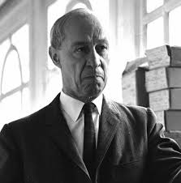
What is Likert scale?
The Likert scale was invented by American social psychologist Rensis Likert. He developed the psychometric scale in 1932 as part of his doctoral dissertation at Columbia University.
A Likert scale is a psychometric rating scale commonly used in surveys to measure people's attitudes, opinions, or behaviors. Instead of a simple "yes" or "no," respondents choose from a graduated range of options (e.g., from "strongly disagree" to "strongly agree") to indicate the intensity of their feelings.
Rensis Likert
1903-1981

Slide 64
1. Likert’s scale
A Likert scale is a unidimensional scale that researchers use to collect respondents’ attitudes and opinions. Researchers often use this psychometric scale to understand the views and perspectives towards a brand, product, or target market.
Types of Likert Scales
The Likert Scale has become a favorite among researchers to collect opinions about customer satisfaction or employee experience. You can divide this scale primarily into two major types:
Even Likert Scale.
Odd Likert Scale.

Slide 65
a. Even Likert Scale
Researchers use even Likert scales to collect extreme feedback without providing a neutral option.
4-Point Likert Scale for importance: This type of Likert scale allows researchers to include four extreme options without a neutral choice. Here the various degrees of importance are represented in a 4-Point Likert Scale.
8-Point Likelihood of recommendation: This is a variation of the previously explained 4-point Likert scale, the only difference being, this scale has eight options to collect feedback about the likelihood of a recommendation.

Slide 66
4 Point Scale
Four-point Likert scale example for agreement
The ambiance of the hotel is most attractive.
Strongly agree
Agree
Disagree
Strongly disagree
For Likelihood
How likely are you to recommend this hotel?
Very unlikely
Unlikely
Likely
Very likely
For Satisfaction
How are satisfied with the hotel food quality?
Very satisfied
Satisfied
Dissatisfied
Very dissatisfied
For Frequency
How frequently do you visit our hotel?
Never
Rarely
Often
Every Time
For Rating
How would you rate the staff friendliness?
Excellent
Good
Better
Poor

Slide 67
b. Odd Likert Scales
Odd Likert Scale
Researchers use the odd Likert scale to give the respondents the choice of responding neutrally.
5-point Likert scale: With five answer options, researchers use this odd Likert scale question to gather information about a topic by including a neutral answer option for respondents to select if they don’t wish to answer from the extreme choices in their research design.
7-point Likert scale: The 7-point Likert scale adds two more answer options at extreme ends of a 5-point Likert scale question.
9-point Likert scale: A 9-point Likert scale is quite uncommon, but you can use it by adding two more answer options to the 7-point Likert scale question.

Slide 68
5 Point Scales

Slide 69
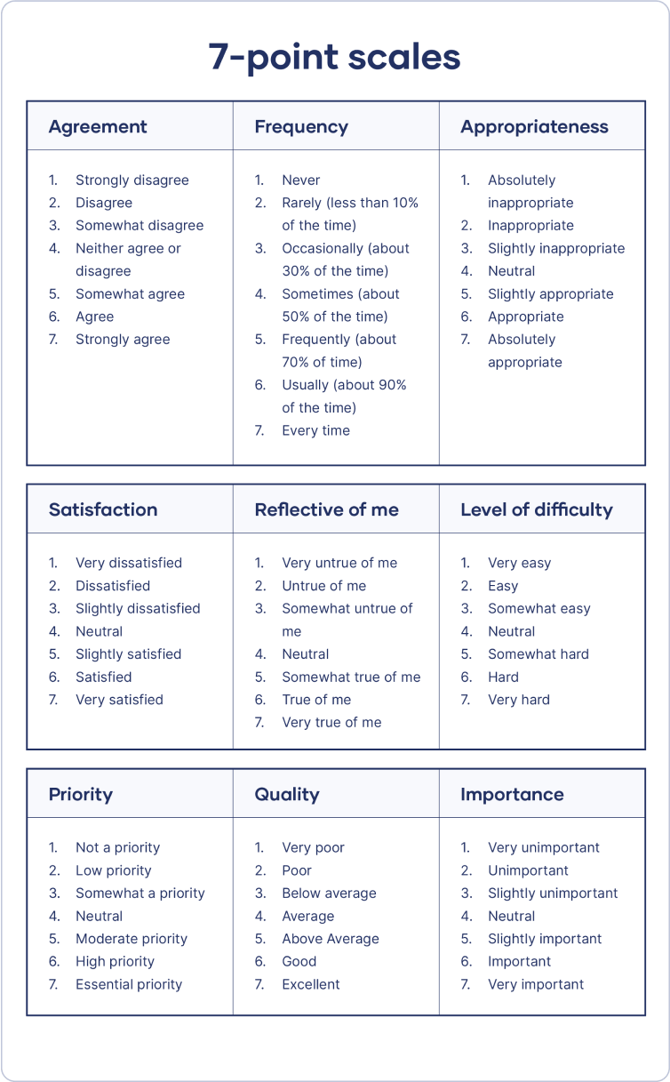
7 Points Likerts Scales

Slide 70
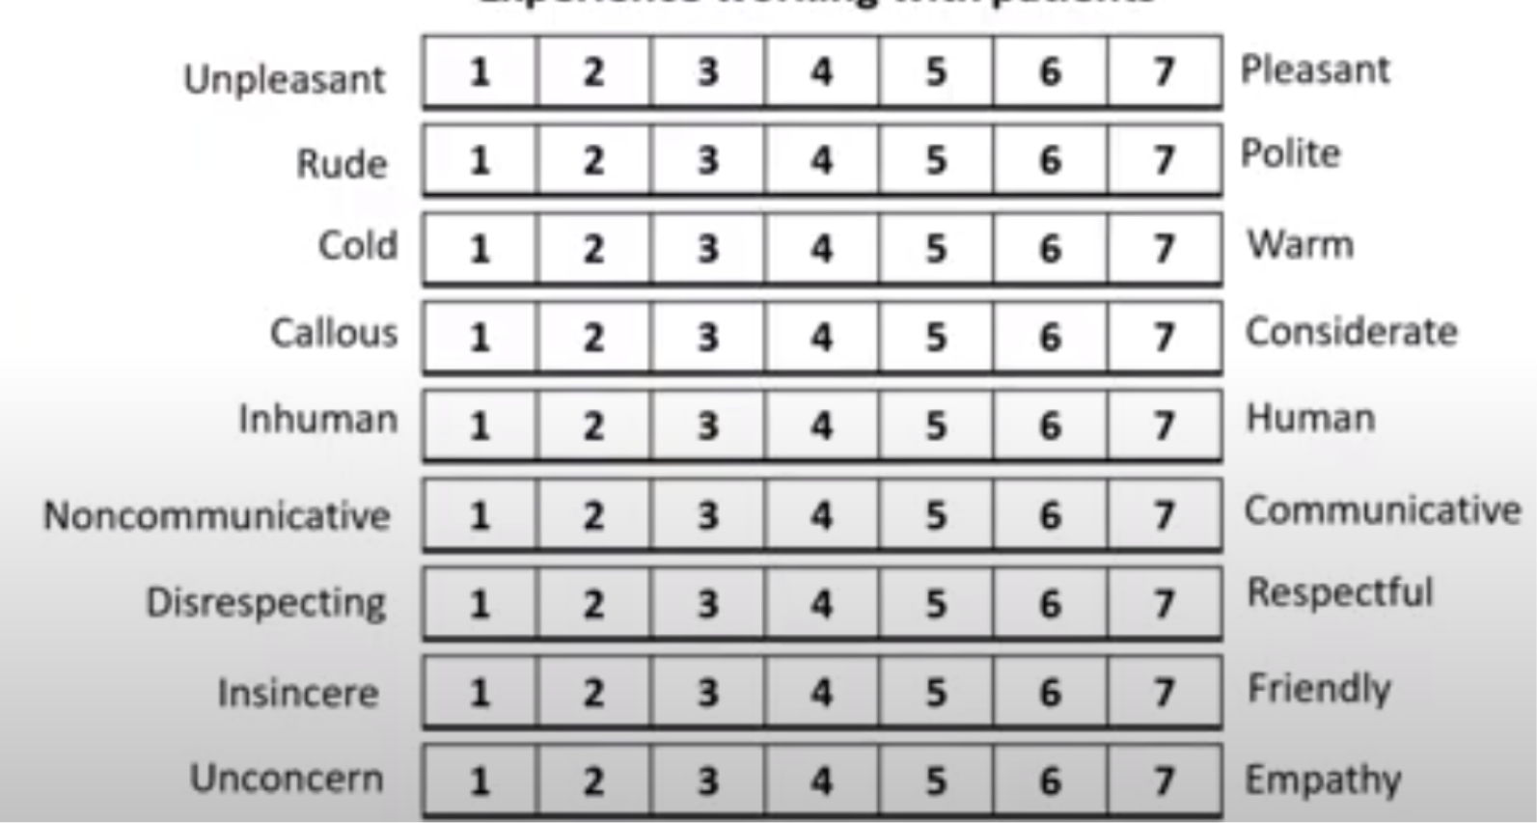
2. The semantic differential scale
The semantic differential scale is used for measuring the meaning of things and concepts (Snider & Osgood, 1969). Participants indicate where they feel a product or experience lies on a 7-point scale between polar adjectives (e.g., strong-weak, good-bad).

Slide 71
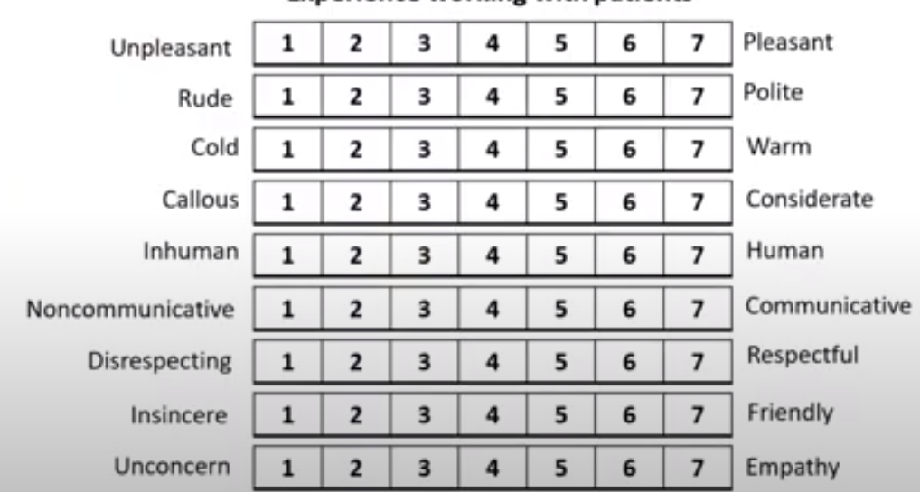
Example of Semantic Differential Scale

Slide 72
Thurstone Scale
The Thurstone scale is a psychometric measurement tool developed by Louis Leon Thurstone in 1928. It’s sometimes seen as a forerunner to the Likert scales as both of them are made of statements about a topic.
But in the Thurstone scale, respondents reply to a list of related agree-disagree-neutral statements of varying weights. The respondent’s attitude is calculated as the sum total of the statements they agree with.
Unlike Likert scales which only allow respondents to provide one answer per question, Thurston scales allow them to give multiple answers by assigning each item on the list a score (usually 1-11). This allows researchers to get more detailed results from their surveys.

Slide 73
Steps involved in developing the Thurstone Scale.
Step 1: Pin down your research question. It should be related to attitude, and should focus on a single topic, like “end-of-life care” or “performance related pay”.
Step 2: Create a list of statements that agree, disagree with or are neutral about the topic to varying degrees. The more statements you come up with, the more useful your data will be.
Step 3: Assign a score to each statement from 1-11 based on how supportive you believe the statement is. A higher score equals a more supportive stance while a lower score equals a more unfavorable stance. The scores are usually assigned in consensus with a panel of experts to reduce bias.
Step 4: Each member of the panel should assign an individual score to each statement. Based on the mean of these scores, each statement is assigned an overall score and sorted in ascending order.
Step 5: Once all of your questions have been created, you will then need to conduct pilot interviews with potential respondents. This helps determine whether or not your questions are clear and easy enough for them to understand.

Slide 74
Example of developing Thurstone scale
For example, you are creating a Thurston questionnaire on employee attitudes toward performance-related pay (PRP). Your statements may include:
PRP gives an incentive to go above and beyond job expectations.
Good performers are rewarded fast due to PRP.
PRP makes team members less willing to help out.
PRP increases the quality of the work.
Management uses PRP to unjustly reward favorites.

Slide 75
Suppose there are 10 judges giving their opinions
Questions/ Options | 1 | 2 | 3 | 4 | 5
1 | 1 | 1 | 1 | 1 | 1
2 | 1 | 1 | 5 | 1 | 2
3 Ist Quortile | 6 (Mean= 2) | 5 (Mean=2) | 1 (Mean =2) | 0 (Mean= 0.4) | 2 (Mean=1.4)
4 | 0 | 1 | 2 | 0 | 1
5 | 2 | 2 | 1 | 0 | 1
6 ( Median | 0 | 0 | 0 | 0 | 0
7 | 0 | 0 | 0 | 0 | 1
8 | 0 | 0 | 0 | 6 | 1
9 3rd quortile | 0 (Mean=0) | 0 (Mean=0) | 0 (Mean=0) | 2 (Mean=2) | 1 (Mean= 0.6)
10 | 0 | 0 | 0 | 2 | 0
11 | 0 | 0 | 0 | 0 | 0
Total | 10 | 10 | 10 | 10 | 10

Slide 76
Advantages
You can write as many statements as you want in the Thurston scale questionnaire. In fact, the more statements you have, the richer your data will be.
The Thurston scale is more reliable because it’s designed by experts.
The Thurston scale lets you assign an average score for each respondent. This lets you compare the results of different respondents and make predictions.

Slide 77
Disadvantages
The Thurston scale can be time consuming, in terms of both designing the surveys and analyzing the results.
Thurstone scales are complex to execute and will require you to do some mathematical calculations. If you just want to quickly create some questions and share the survey, this might not be the right tool for you.

Slide 78
Multidimensional Scaling Techniques
Multidimensional Scaling (MDS) is a class of procedures for representing perception and preferences of respondents spatially by means of a visual display. Perceived or psychological relationships among points in a multidimensional space. These geometric representations are often called spatial maps. The axes of the spatial map are assumed to denote the psychological bases or underlying dimensions respondents use to form perceptions and preferences for stimuli. MDS has been used in marketing to identify:
1. The number and nature of dimensions consumers use to perceive
different brands in the marketplace
2. The positioning of current brands on these dimensions
3. The positioning of consumers ideal brand on these dimensions

Slide 79
Application of Multi Dimensional scaling
Image measurement. Compare the customers’ and noncustomers’ perceptions of the firm with the firm’s perceptions of itself and thus identify perceptual gaps.
Market segmentation. Position brands and consumers in the same space and thus identify groups of consumers with relatively homogeneous perceptions.
New product development. To look for gaps in the spatial map, which indicate potential opportunities for positioning new products. Also, to evaluate new product concepts and existing brands on attest basis to determine how consumers perceive the new concepts. The proportion of preferences for each new product is one indicator of its success.
Assessing advertising effectiveness. Spatial maps can be used to determine whether advertising has been successful in achieving the desired brand positioning.
Pricing analysis. Spatial maps developed with and without pricing information can be compared to determine the impact of pricing. ▪ Channel decisions. Judgments on compatibility of brands with different retail outlets could lead to spatial maps useful for making channel decisions.
Attitude scale construction. MDS techniques can be used to develop the appropriate dimensionality and configuration of the attitude space.

Slide 80
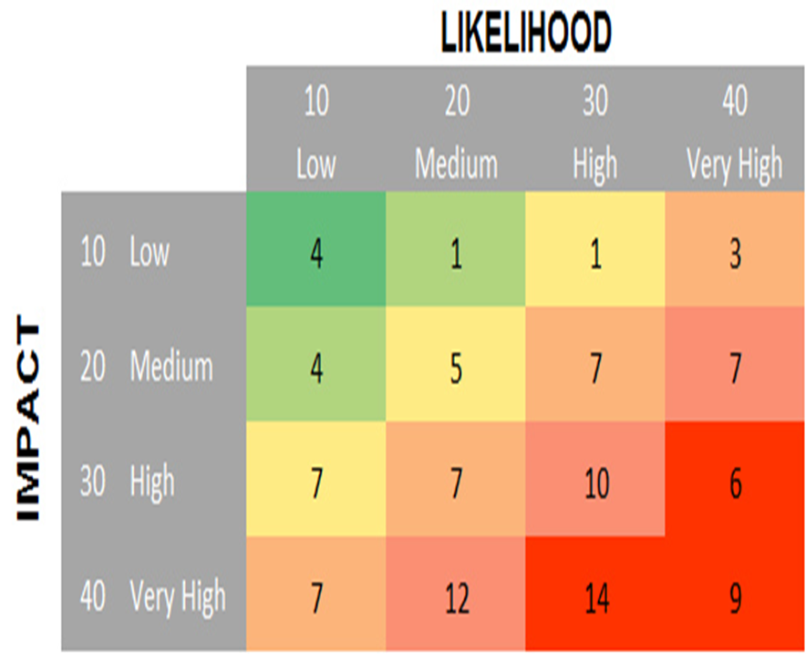
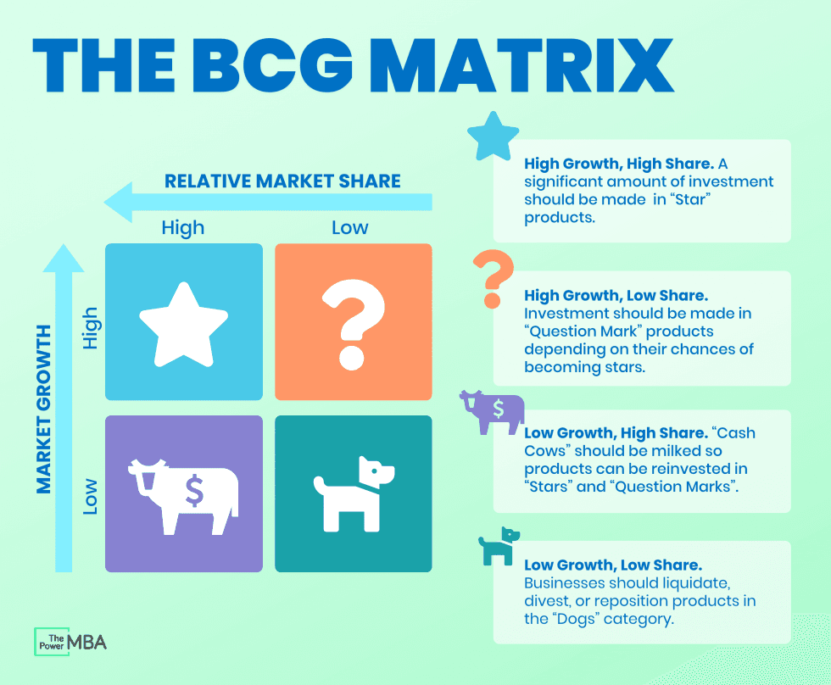
Example of multi dimensional Scaling

Slide 81
Practical example
Research Problem
A smartphone company wants to know how customers perceive different smartphone brands.
Suppose five brands are selected:
Samsung
Apple
OnePlus
Vivo
Redmi

Slide 82
Assume 50 respondents rated the similarity between every pair of brands on a scale of
1 = Very Similar
10 = Very Different
The average ratings are shown below.

Slide 83
Survey result
Brand | Samsung | Apple | OnePlus | Vivo | Redmi
Samsung | 0 | 6 | 3 | 5 | 4
Apple | 6 | 0 | 5 | 8 | 9
OnePlus | 3 | 5 | 0 | 4 | 5
Vivo | 5 | 8 | 4 | 0 | 2
Redmi | 4 | 9 | 5 | 2 | 0

Slide 84
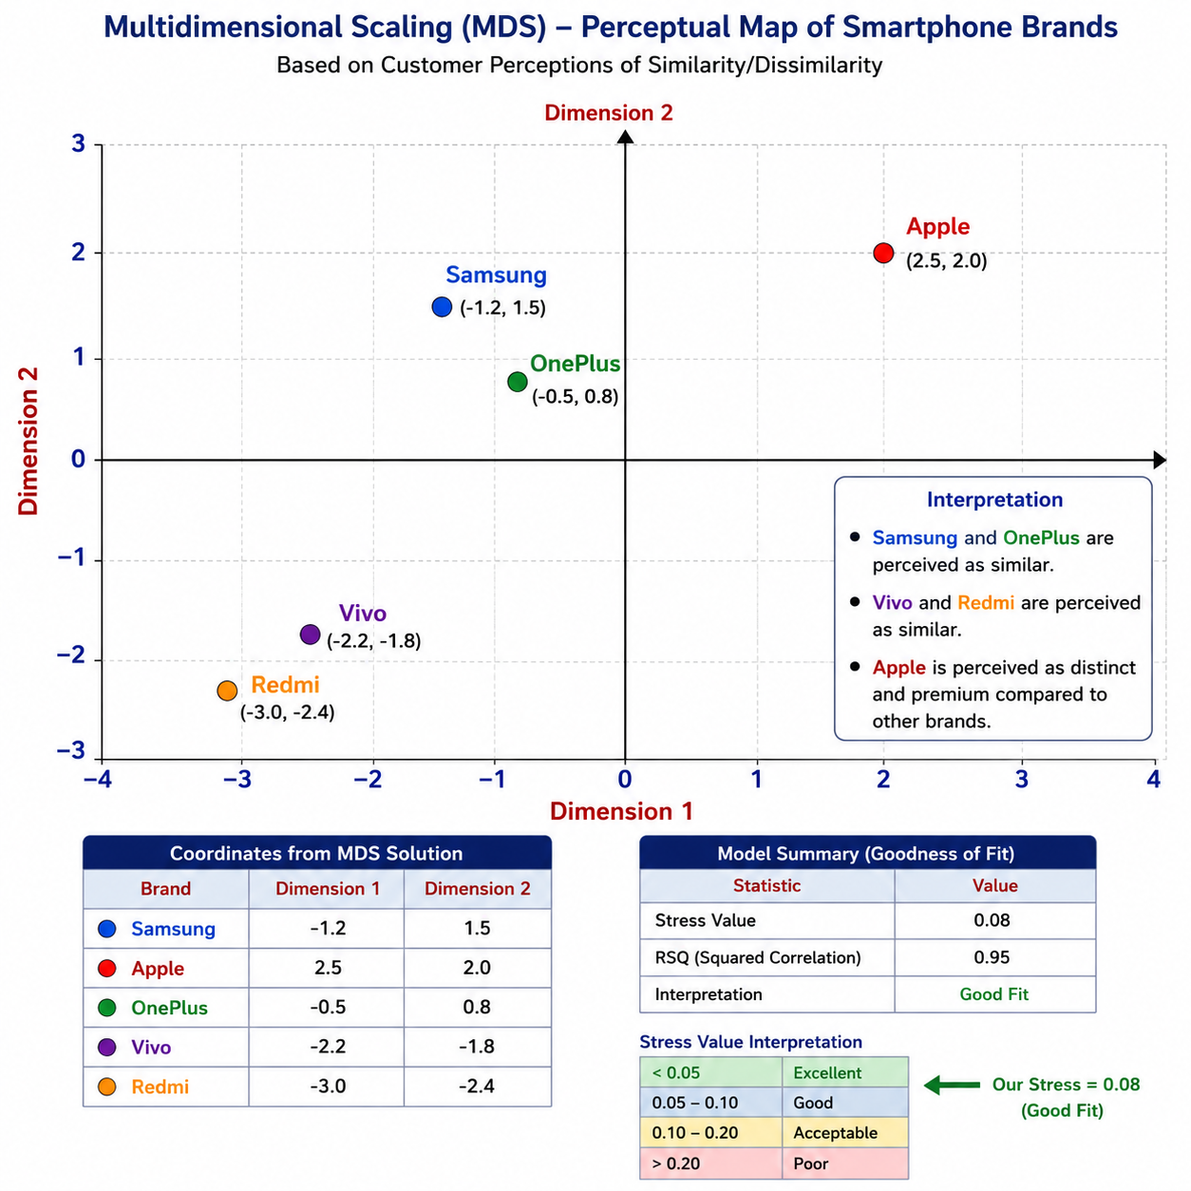

Slide 85
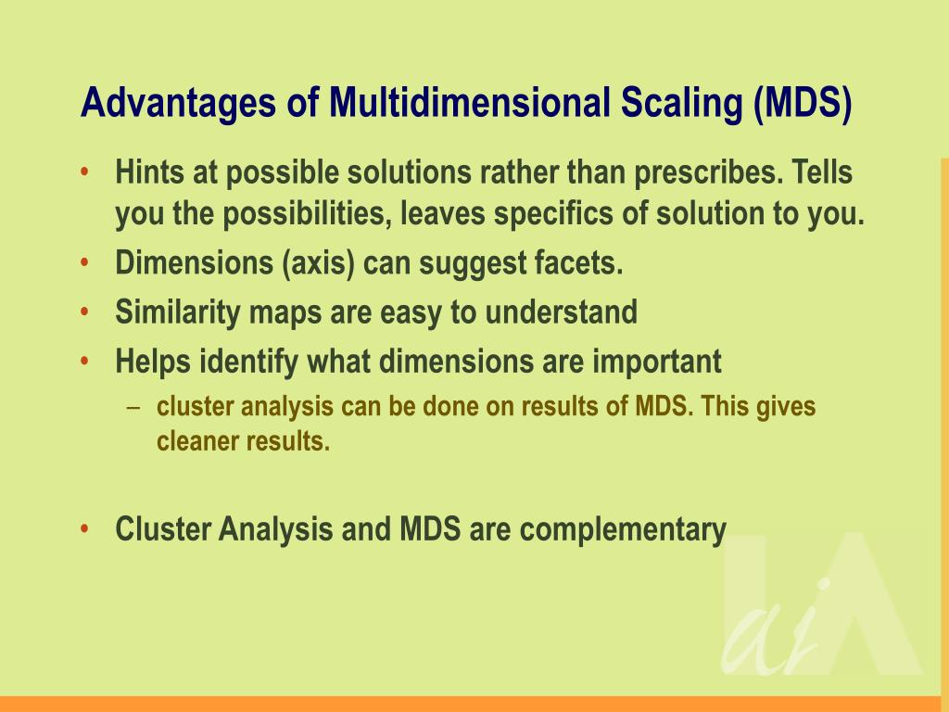

Slide 86
Limitations of MDS

